Slide 1


决策树算法概况
路亮

Slide 2

目录
决策树建模思路
决策树建模基本原理
Quinlan系列决策树（ID3,C4.5,C5.0)原理
CART建模原理（略）
模型修剪
模型评估
随机森林与组合算法
Notes:
Half Circle
(Advanced)
To reproduce the effects on this slide, do the following:
On the Home tab, in the Slides group, click Layout, and then click Blank.
On the Design tab, in the Themes group, click the arrow next to Colors and then click Metro.
On the Insert tab, in the Media group, click Video, and then click Video from file.
In the left pane of the Insert Video dialog box, click the drive or library that contains the video. In the right pane of the dialog box, click the video that you want and then click Insert.
Tip: For best results with the video on this slide, use a video that is square in format, or use the Crop tool to square video on slide.
Under Video Tools, on the Format tab, in the Video Styles group, click the arrow to the right of Video Shape and under Basic Shapes select Chord (second row, second option from left).
Drag the top Yellow Adjustment Handle counter clockwise stopping at the bottom center, aligned with the bottom center sizing handle.
Drag the second Yellow Adjustment Handle counter clockwise stopping at the top center, aligned with the top center sizing handle, creating a half circle.
Select the video, on the Home tab, in the Drawing group, click Arrange, point to Align, and select Align Middle.
With the video still selected, under Video Tools, on the Format tab, click the arrow in the bottom right corner of the Video Styles group to open the Format Video dialog box.
In the Format Video dialog box, click Position in the left pane, under Position on Slide in the right pane, set the Horizontal to -3.43” from Top Left Corner.
Also in the Format Video dialog box, click Shadow in the left pane, under Shadow in the right pane enter the following:
Color: Black, Text 1 (under Theme Colors, first row, second option from left)
Transparency: 14%.
Size: 100%.
Blur: 20 pt.
Angle: 0°Degrees.
Distance: 3 pt.
Still in the Format Video dialog box, click 3-D Format in the left pane. In 3-D Format on the right pane, under Bevel, click the arrow to the right of Top and under Bevel choose Circle (first option, first row), and then close Format Video dialog.
Select the Video, on the Animations tab, in the Timing group, to the right of Start, choose With Previous.
Under Video Tools, on the Playback tab, in the Video Options group, select Loop until Stopped.
To reproduce the shape effects on this slide, do the following:
On the Home tab, in the Drawing group, click Shapes, and then under Basic Shapes, click Arc (third row, twelfth option from the left). On the slide, drag to draw an arc.
Drag the right Yellow Adjustment Handle to the bottom center to create a half-circle.
Select the arc. Under Drawing Tools, on the Format tab, in the Size group, do the following:
In the Shape Height box, enter 6.75”.
In the Shape Width box, enter 10”.
With the arc still selected. On the Home tab, in the Drawing group, click Arrange, point to Align, and click Align Middle.
Under Drawing Tools, on the Format tab, in the bottom right corner of the Size group, click the arrow opening the Format Shape dialog box.
In the Format Shape dialog, click Position in the left pane, under Position and Size in the right pane set the Horizontal to -5.01”.
Also in the Format Shape dialog box, click Line Color in the left pane, under Line Color in the right pane, select Solid line and then do the following:
Click the button next to Color, and then under Theme Colors click White, Background 1 (first row, first option from the left).
In the Transparency box, enter 50%.
In the Format Shape dialog box, click Line Style in the left pane. Under Line Style in the right pane, set the Width to 1.5 pt. Close the Format Shape dialog.
Select the arc. On the Home tab, in the Clipboard group, click the arrow to the right of Copy, and then click Duplicate.
Select the second arc. Under Drawing Tools, on the Format tab, in the bottom right corner of the Size group, click the arrow opening the Format Shape dialog box.
In the Format Shape dialog, click Size in the left pane, under Size and Rotate in the right pane set the Height to 7” and the Width to 9.5”.
In the Format Shape dialog, click Position in the left pane, under Position and Size in the right pane set the Horizontal to -4.75” and Vertical to .05”.
In the Format Shape dialog box, click Line Color in the left pane, under Line Color in the right pane select Gradient line, then do the following:
Type: Linear
Direction: Linear Down (first row, second option from the left).
Under Gradient stops, click Add gradient stop or Remove gradient stop until two stops appear on the slider. Customize the gradient stops as follows:
Select the first stop in the slider, and then do the following:
In the Position box, enter 0%.
Click the button next to Color, and then under Theme Colors click Blue-Grey,Text 2, Lighter 80% (second row, fourth option from the left).
In the Transparency box, enter 70%.
Select the second stop in the slider, and then do the following:
In the Position box, enter 100%.
Click the button next to Color, and then under Theme Colors click Periwinkle, Accent 5, Lighter 80% (second row, ninth option from the left).
In the Transparency box, enter 90%.
Also in the Format Shape dialog box, click Line Style in the left pane. Under Line Style in the right pane, set the Width to 4.5 pt.
Close the Format Shape dialog box.
To reproduce the text effects on this slide, do the following:
On the Insert tab, in the Text group, click Text Box, and then on the slide drag to draw your text box.
With the text box selected type in desired title text (“Title”).
Select the text. On the Home tab, in the Font group, do the following:
Select Calibri (Headings) in the font list.
Click the Bold icon.
In the Font Size box, enter 36 pt.
Also on the Home tab, in the Paragraph group, select the Center Text icon.
Select the text box. Under Drawing Tools, on the Format tab, click the arrow in the bottom right corner of the WordArt Styles group to open the Format Text Effects dialog box.
In the Format Text Effects box, select Reflection in the left pane and in Reflection on the right pane click the arrow to the right of Presets and under Reflection Variations select Half Reflection 4 pt Offset (second row, second option from left). Close the Format Text Effects dialog.
Also under the Drawing Tools, on the Format tab, in the Size group, click the arrow at the bottom right corner opening the Format Shape dialog box.
In the Format Shape dialog box, select Position in the left pane, under Position in the right pane do the following:
In the Horizontal box, enter 4.57” from Top Left Corner.
In the Vertical box, enter 0.33” from Top Left Corner. Close the Format Shape dialog.
On the Insert tab, in the Text group, click Text Box, and then on the slide drag to draw your text box.
With the text box selected type in desired body copy text.
Select the text. On the Home tab, in the Font group, select Calibri from the Font list, and then select 28 pt from the Font Size list.
Under Drawing Tools, on the Format tab, in the Size group, click the arrow at the bottom right corner launching the Format Shape dialog box, select Position in the left pane, and in the Position pane do the following:
In the Horizontal box, enter 5” from Top Left Corner.
In the Vertical box, enter 1.9” from Top Left Corner.
Close the Format Shape dialog box.
To reproduce the background on this slide, do the following:
On the Design tab, in the bottom right corner of the Background group, click the arrow opening the Format Background dialog box.
In the Format Background dialog, click Fill in the left pane. Under Fill in the right pane, select Gradient fill, and then do the following:
Type: Linear.
Direction: Linear Up (second row, second option from the left).
Angle: 270 Degrees.
Under Gradient stops, click Add gradient stop or Remove gradient stop until four stops appear on the slider.
Select the first stop in the slider, and then do the following:
In the Position box, enter 0%.
Click the button next to Color, and then under Theme Colors click Blue-Grey, Text 2, Lighter 80% (second row, fourth option from the left).
Select the second stop in the slider, and then do the following:
In the Position box, enter 30%.
Click the button next to Color, and then under Theme Colors click White, Background 1 (first row, first option from the left).
Select the third stop in the slider, and then do the following:
In the Position box, enter 70%.
Click the button next to Color, and then under Theme Colors click White, Background 1 (first row, first option from the left).
Select the fourth stop in the slider, and then do the following:
In the Position box, enter 100%.
Click the button next to Color, and then under Theme Colors click Blue-Grey, Text 2, Lighter 60% (third row, fourth option from the left).
Close the Format Background dialog.

Slide 3
1
决策树建模思路

Slide 4
决策树建模思路
怎么用决策树帮女神找男朋友？
某女神白净美，挑男朋友自然苛刻些，别人问她有什么要求，总是说：“要有经济基础”，“我有1.68，所以男方也不能太矮吧”，“长得嘛！也不能太矬吧”等等诸如此类。红娘也判断不出她到底想要什么样的，于是就一拖再拖，转眼成了剩女神。
女神也急啊，这可怎么办呢？

Slide 5
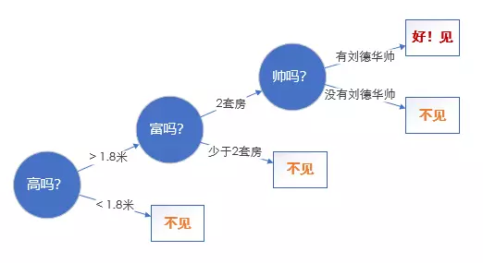
决策树建模思路

Slide 6
决策树算法概述
70年代后期到80年代初，Quinlan开发了ID3算法（迭代的二分器），后来Quinlan改进了ID3算法，称为C4.5算法，然后又发布了C5.0
1984年，多位统计学家在著名的《Classification and regression tree》书里提出了CART算法
ID3和CART几乎同期出现，引起了研究决策树算法的风潮，至今已经有多重算法被提出，适用于不同数据下解决不同问题，具体的在这里就不多做阐述

Slide 7
决策树算法概述
什么是决策树？

决策树是以树形结构组织的规则集合
易于理解是如何预测
易于构建和可视化
简约表示和执行能力
是一个有效的数据挖掘技术
X₁>W₁
Yes
No
X₂
X₂>W₂
C₂
Yes
No
C₁
W₂
C₁
C₂
C₁
W₁
X₁

Slide 8
决策树算法概述
决策树的路径

决策树的路径解释了预测
X₁>W₁
是对数据的探索
是对数据轮廓的描述
能进行预测和分类
了解哪些变量更重要
能发现意料之外的模式
Yes
No
X₂>W₂
Yes
No
C₁
C₂
C₁

Slide 9
2
决策树建模基本原理

Slide 10
决策树建模基本原理
例：某学校学生挂科数据
在线学习时间 | 家庭年收入 | 是否吃早点 | 曾经挂科 | 考试是否及格
<=30 | 高 | no | yes | no
<=30 | 高 | no | no | no
31...50 | 高 | no | yes | yes
>50 | 中 | no | yes | yes
>50 | 低 | yes | yes | yes
>50 | 低 | yes | no | no
31...50 | 低 | yes | no | yes
<=30 | 中 | no | yes | no
<=30 | 低 | yes | yes | yes
>50 | 中 | yes | yes | yes
<=30 | 中 | yes | no | yes
31...50 | 中 | no | no | yes
31...50 | 高 | yes | yes | yes
>50 | 中 | no | no | no

Slide 11
决策树建模基本原理
例：期待输出的结果
在线学习时间
<=30
31..50
<=50
是否吃早点？
yes
是否吃早点？
no
yes
no
yes
no
yes
no
yes

Slide 12
决策树建模基本原理
寻找最纯净的分组方法
X₂
C₂
W₂
C₁
W₁
X₁

Slide 13
决策树建模基本原理
算法的核心问题
该按什么样的次序来选择变量（属性）？
最佳分离点（连续的情形）在哪儿？

Slide 14
决策树建模基本原理
拆分规则
表在线学习时间-考试是否及格
 |  | 考试是否及格 |  | 合计
 |  | no | yes
在线学习时间
31...50 | 频数 | 0 | 4 | 4
<=30 | 频数 | 3 | 2 | 5
>50 | 频数 | 2 | 3 | 5
合计 | 频数 | 5 | 9 | 14
entropy | Gini | Logworth
ID3,C4.5,C5.0 | CART | CHAID
0.246 | 0.102 | 1.3
0.029 | 0.016 | 0.74
家庭年收入-考试是否及格
 |  | 考试是否及格 |  | 合计
 |  | no | yes
在线学习时间
高 | 频数 | 2 | 2 | 4
中 | 频数 | 1 | 3 | 4
低 | 频数 | 2 | 4 | 6
合计 | 频数 | 5 | 9 | 14

Slide 15

3
Quinlan系列决策树

Slide 16
ID3决策树原理介绍
建模步骤
一、建树
选择最有解释力度的变量
对于每个变量选择最优分割点
二、剪树
前向剪枝：控制生成树的规模
后向剪枝：删除没有意义的组

Slide 17
ID3决策树原理介绍
信息增益计算

Slide 18
ID3决策树原理介绍
信息增益计算
在线学习时间的信息增益最高，故首先选择这个变量

Slide 19
ID3决策树原理介绍
信息增益计算
通过这种方法，我们得到了在线时间的信息增益
同样的，我们可以得到Gain(income）=0.029位，Gain(breakfast)=0.151,Gain(fail)=0.048
由于在线时间具有最高的信息增益，所以它被选为分裂属性。结点用time标记，并且每个属性值生长出一个分枝，然后元组据此划分
在线学习时间的信息增益最高，故首先选择这个变量

Slide 20
ID3决策树原理介绍
ID3的缺点
ID3倾向于选择水平数量较多的变量
输入变量必须是分类变量（连续变量必须离散化）

Slide 21
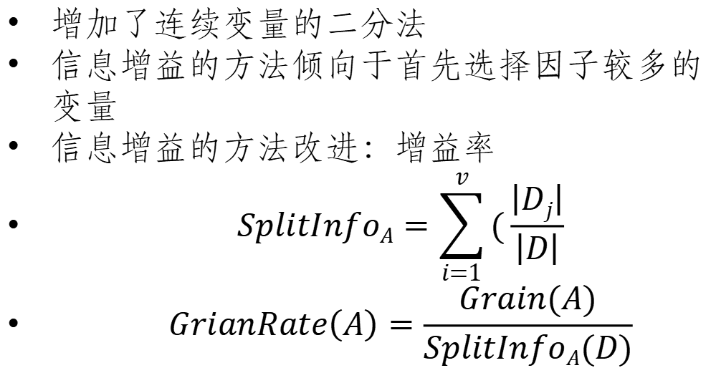
ID3决策树原理介绍
C4.5
增加了连续变量的二分法
信息增益的方法倾向于首先选择因子较多的变量
信息增益的方法改进：增益率
$$SplitInfoA=\sum_{i=1}^{v}{(\frac{\left|Dj\right|}{\left|D\right|}}$$
$$GrianRate\left(A\right)=\frac{Grain(A)}{SplitInfoA(D)}$$

Slide 22
单个分类或等级变量，决策树遍历搜索
对于分类变量，假设该收入变量有4个水平，则依次遍历所有的组合形式，计算熵增益率最大的那个组合方式
A1 V.S A2 V.S A3 V.S A4
A1、A2 V.S A3 V.S A4
A1 V.S A2 、 A3 V.S A4
A1 V.S A2 V.S A3 、 A4
……
C4.5不能处理等级变量，要么作为分类变量，要么作为连续变量。这需要分析人员提前设置好。设为因子类型即为分类变量，否则为连续变量。

Slide 23
单个分类或等级变量，决策树遍历搜索
对于连续变量，先等宽分为50组，依次取阈值分割成两组，计算熵增益率变化最大的那个分割方式
C4.5不能处理等级变量，要么作为分类变量，要么作为连续变量。这需要分析人员提前设置好。设为因子类型即为分类变量，否则为连续变量。

Slide 24
比较多个变量的优先级
假设都是连续变量，先各自做分割，并计算各自的熵增益率
比较每个变量所能达到的最大熵增益率，取最大的那个作为本次分割选择的变量，该变量对应最大熵增益率的分割依据

Slide 25
C5.0算法
建树：
• 沿用C4.5的方法
剪枝：
• 前剪枝：
• minCases叶子的最小样本量
• winnow事先是否进行变量相关性筛选
• 后剪枝：
• CF越小，要求模型的置信度越高
• noGlobalPruning事后拆分规则有用性检验
参考书：
Quinlan R (1993). C4.5: Programs for Machine Learning. Morgan Kaufmann Publishers
主要创新处：
• 纳入了Boost的方法，可以做组合模型
参考书：
Quinlan R (1993). C4.5: Programs for Machine Learning. Morgan Kaufmann Publishers

Slide 26
5
模型修剪

Slide 27
剪枝
在决策树创建时，由于数据中的噪音和离群点，许多分枝反映的是训练数据中的
异常。剪枝方法处理这种过分拟合的数据会影响模型的稳定性。通常使用统计度
量剪掉最不可靠的分枝。剪枝后的树更小、更简单、更容易理解。
一、预修剪
其目标是控制决策树充分生长，可以事先指定一些控制参数，包括：
（1）决策树最大深度。如果决策树的层数已经达到指定深度，则停止生长 。
（2）树中父节点和子节点的最少样本量或比例。对于父节点，如果节点的样
本量低于最小样本量或比例，则不再分组；对于子节点，如果分组后生成的子
节点的样本量低于最小样本量或比例，则不必进行分组 。
（3）树节点中输出变量的最小异质性减少量。如果分组产生的输出变量异质
性变化量小于一个指定值，则不必进行分组。
剪枝策略：

Slide 28
剪枝
二、后剪枝
后修剪技术允许决策树充分生长，然后在此基础上根据一定的规则，剪去决策树中那些不具有一般代表性的叶节点或子树，是一个边修剪边检验的过程。在修剪过程中，应不断计算当前决策子树对测试样本集的预测精度或误差，并判断应继续修剪还是停止修剪。
•CART采用的后修剪技术称为最小代价复杂性修剪法（Minimal Cost Complexity Pruning,MCCP）
•MCCP有这样的基本考虑：首先，考虑的决策树虽然对训练样本有很好的预测精度，但在测试样本和未来新样本上不会仍有令人满意的预测效果；其次，理解和应用一棵复杂的决策树是一个复杂过程。因此，决策树修剪的目标是得到一棵“恰当”的树，它首先要具有一定的预测精度，同时决策树的复杂程度应是恰当的。
CART选择最终子树标准是：选择交叉验证中错误最小的

Slide 29
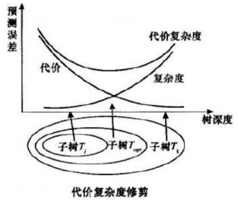

Slide 30

6
模型评估

Slide 31
样本内评估
决策类模型评估
排序类模型的评估指标
ROC曲线
Gini系数
累积提升度
K-S统计量
K-S曲线

Slide 32

谢谢！

